Slide 1
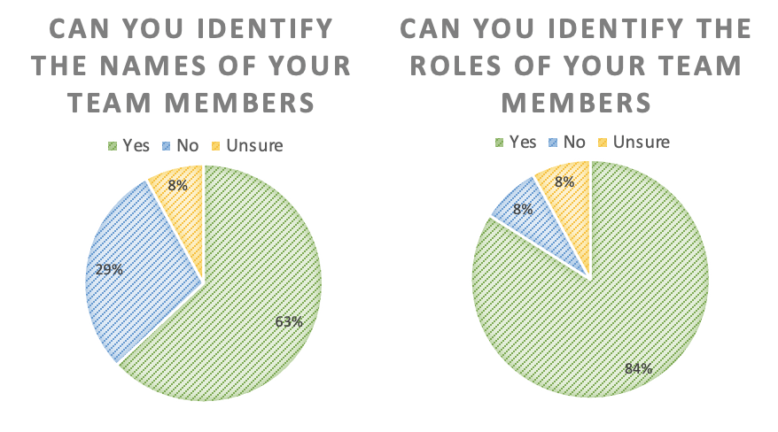
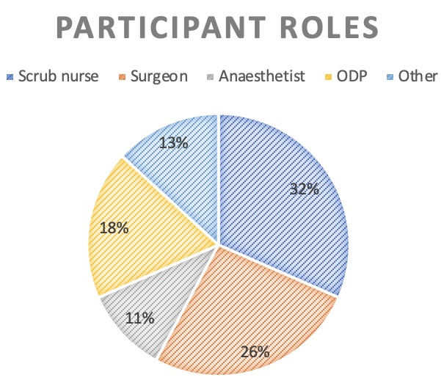
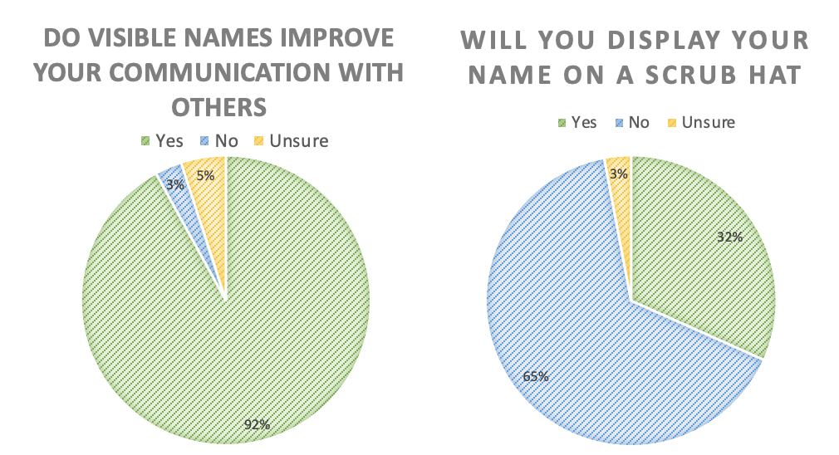
What's in a name?
Dr Rachel Moloney¹, Dr York-Mui Liu², Dr Anoop Patel³
1:Foundation year 2 doctor, 2-3: Consultant anaesthetist
The Luton and Dunstable University Hospital
Introduction
Methods
Results
Discussion
The need to don personal protective equipment (PPE) in the workplace during the COVID pandemic has had a profound impact on effective communication.¹
The World Health Organisation (WHO) Surgical Safety Checklist (SSC) was introduced to the NHS in January 2009 and has been associated with improving communication within the theatre environment, translating into a tangible reduction in surgical complications.²
The social media initiative #theatrecapchallenge aimed to offset the verbal communication difficulties whilst wearing PPE by having names clearly visible on scrub hats.
Following approval from our local audit department, qualitative and quantitative data was collected from a survey using a mixture of closed ranking and multiple-choice questions.
The questions assessed how effectively staff could recall the names and roles of individuals after a WHO team brief, and if it was adequate for identifying individuals.
There is a significant disparity between the permanent theatre staff and those rotating through the emergency theatre environment.
The lower rate of engagement from the scrub team suggested an already established rapport, and the ability to infer the roles of others by positioning.
This initiative would be of most benefit to the rotational staff, such as trainee surgeons and anaesthetists and surgeons.
All but one respondent agreed knowing the name of team members would enhance communication.
In an emergency situation, 92% agreed visible names of individuals would be beneficial.
Despite 100% of the surgeons and anaesthetists being keen to partake, only 30% of the scrub team felt it would be worthwhile.
Results
38 staff members participated in the survey.
Whilst 63% could confidently identify team members by their names, 84% could accurately identify the roles of individuals.
Regarding the SSC, 74% felt it was a good tool for identifying names and roles of individuals.
Conclusion
Although there was enthusiasm for the project both locally and on social media, there were multiple barriers that ultimately prevented implementation.
Barriers included practicalities, environmental factors, time and financial delay from the outset
Improved communication during the team safety brief, and clearly writing out names would achieve the same the result.
Objectives
Our aim was to evaluate professional and personal attitudes towards wearing names visibly on foreheads
If visible names would improve communication whilst in PPE.
To assess if the initiative was feasible within our workplace.
References
^{1.}Hampton T, Crunkhorn R, Lowe N, et al. The negative impact of wearing personal protective equipment on communication during coronavirus disease 2019. 2020;134(7):577-581. doi:10.1017/S0022215120001437.
² Decade of improved outcomes for patients thanks to Surgical Safety Checklist 21January 2021. https://www.england.nhs.uk/2019/01/surgical-safety-checklist/

